Slide 1
Gram Panchayat perspective plan and Localised Sustainabnle Development Goals – Karnataka initiatives

Slide 2
Introduction
Section 309(b) of Karnataka Gram Swaraj and Panchayat Raj Act 1993 mandates preparation of Vision Plan for 5 years
Shall be based on the Goals set by the Union and State Governments (Focus on Human Development and Sustainable Development Goals)
Goals shall be based on the local problems and shall have the Local Indicator Framework
Indicators should be classified as Immediate, Short , Medium and Long Term
The process shall commence by June 2022 and shall be completed by end of September, 2022

Slide 3
Sectors
Identification gaps in development in the following sectors for preparing the vision plan at GP level
Health
Education
Women and Child Development
Environment and Natural Resources
Local Economic Development activities (Livelihood issues)
Socially Secured
Others

Slide 4
Steps for preparation of Vision Plan
Step - 1 : GP Planning Team(Constitution of
Working Groups)
Step - 2 : Training Programmes
Step - 3 : Data Collection
Step - 4 : Focussed Group Discussions and PRA
Exercise
Step - 5: Situation Analysis
Step - 6: Preparation of Draft Vision
Step - 7: Presentation to GP Standing Committee on Finance, Audit and Planning

Slide 5
Contd...
Step - 8 : Discussion and Approval by the GP
Meeting
Step - 9 : Meetings of Gram Swaraj Units (Ward and Gram Sabha)
Step - 10 : Finalising GP Vision Plan and uploading in designated portal

Slide 6
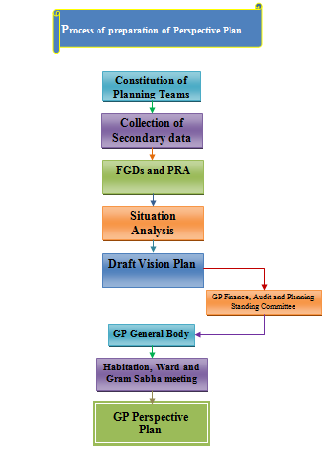

Slide 7
Preparatory exercises
Two workshops with experts organised to fine tune the process
Consultative workshop with field level staff to streamline the process
Finalising the formats for the Vision plan exercise keeping it in tune with Localised Sustainable Development Indicators identified by MoPR

Slide 8
Contd…..
Data collection on various sectors identified for preparation of perspective plan
Identification of indicators in each sectors (focus on LSDGs)
Goals to be set by the GPs based on the identified problems in each sector
All 9 themes of LSDGs to be part of the Planning exercise

Slide 9
Rolling out strategy
Handbook and Process Chart along with formats to be ready by June 10th
Capacity building for State Level Master Trainers during June 3rd and 4th week
Capacity building for the planning team to commence from 1st week of July.
Capacity building activities to be completed before end of July, 2022

Slide 10
Contd…..
GPs to start the process during August 1st week
Perspective plans along with Goals and Targets for each sectoral indicators to be ready by September, 2022
Panchatantra 2.0 software to capture the entire process along with Goals and targets for each sector
Dashboard to assist monitoring process and progress of preparation of GP Perspective Plans

Slide 11
Thanks

